Slide 1

Select Health
+
Making HR & Compliance Made Simple
with Mineral
Notes:
Mineral has close to 20 years of experience helping small and medium-sized businesses with their HR and compliance needs
Over 1.5 million small and medium-sized businesses have access to their services, the largest small and medium-sized business community of any HR and Compliance company.
With Mineral’s stellar reputation in the HR and compliance space, Select Health partnered with Mineral to include their HR and compliance solution for small business employers and Association groups.

Slide 2
The challenge for employers
Law and policy alerts
HR compliance
Termination
DE&I
Employee management
Help!
Leave of absence
Recruiting & hiring
Employee benefits
Workplace safety
Mental health & wellness
Hiring
Job descriptions
Harassment prevention training
Pay transparency
I-9 guidance
ACA Responsibilities
Notes:
Why did Select Health partner with an HR and Compliance company?
To help employers with many of their top business challenges.
Employers today get bogged down with HR and compliance needs from how to properly terminate an employee to using the new I9 forms. And it’s not just the variety of topics and different areas that employers need to manage, it’s the severity in some cases of not being compliant. Not only do they need to react to these changes at a federal level, but also state and in some cases county as well.
Listed here are common challenges and needs employer have when it comes to HR and compliance.
Mineral has the resources to help employers with all of these issues.

Slide 3
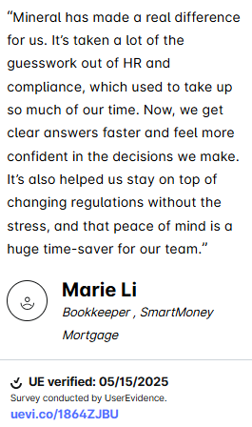
Notes:
Group has completed 60 training courses, utilized the Platform 14 times for self-service, and created a benefit document (broker sponsored too).

Slide 4








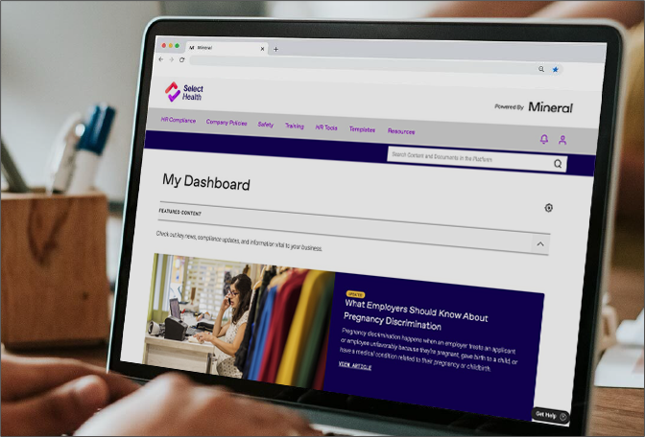


The Mineral Platform™
Access 60+ certified experts
Create & easily maintain employee handbooks
Create ERISA Wrap and POP benefit documents
Workplace safety trainings
The power of data, technology, and human expertise all in one place.
Utilize over 360+ employee training courses
Access a personalized HR & compliance library
Workplace harassment prevention trainings
Templates, sample policies, checklists, and toolkits
Access thousands of downloadable documents
Take an HR & compliance assessment
Notes:
Here is a list of some of the most utilized HR and Compliance tools and resources in the Mineral Platform that is available to clients and is included with the Select Health medical plan.
Where are clients getting help with these needs today? They can save money and time by getting these needs met using Mineral.

Slide 5
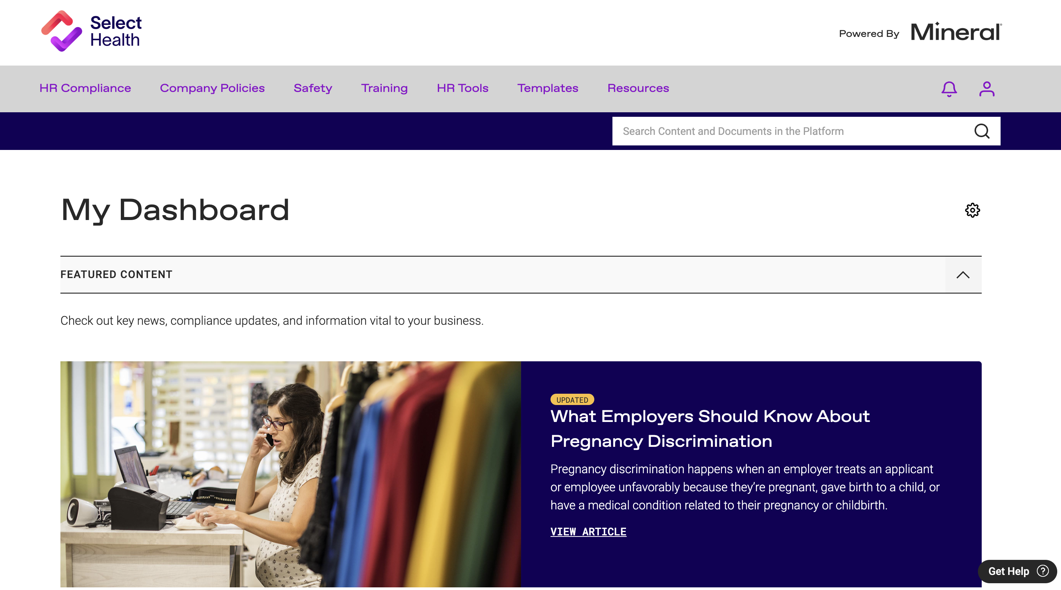
The Mineral Platform™
Notes:
Here is a snapshot of what the Select Health branded Mineral Platform looks like. We are a one stop shop HR and Compliance solution for your clients.
Each client will receive an email notifying them that they now have access to their HR and Compliance platform with Mineral sponsored by Select Health.
Encourage your clients to retrieve their username and set their password to access their company’s personalized HR and Compliance Mineral Platform.

Slide 6
Select Health + Mineral
Utah
Idaho
Utah – small employer fully insured, level funded, and Association plans.
Nevada – small employer fully insured plans.
Idaho – small employer fully insured and Association plans.
Mineral is included as part of the medical plan at no additional cost!
Nevada
Notes:
Who gets access?

Slide 7
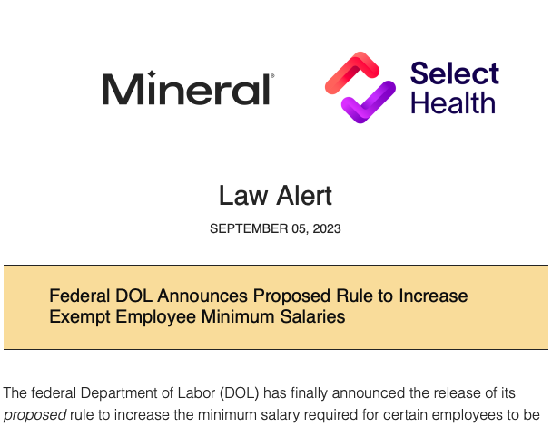
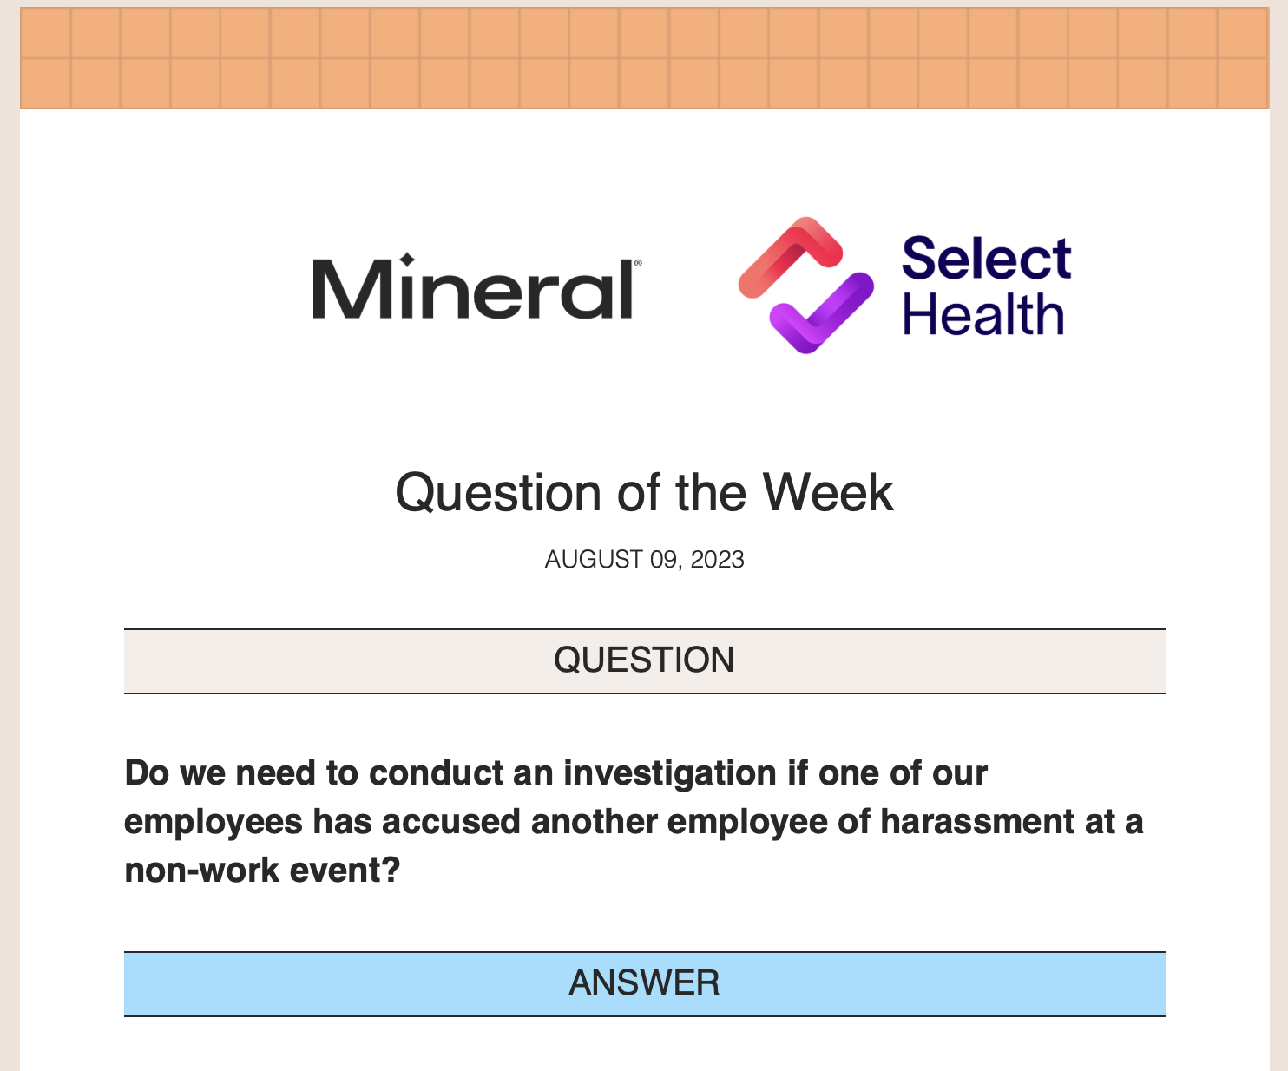
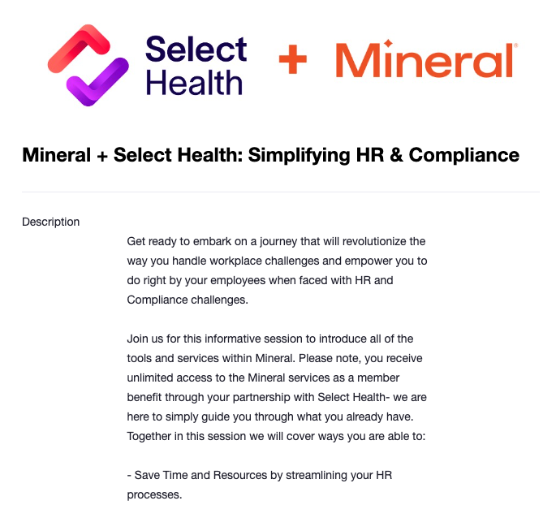
Mineral communication
Law Alerts
Question of the Week
Monthly Webinar Invitations
Notes:
Mineral provides value outside of the Mineral Platform as well.
One of the biggest challenges these smaller businesses have is staying on top of laws and regulations.
Mineral monitors all the federal and state laws so you and your clients don’t have to.
Mineral will proactively reach out to clients and notify them of any new or changing laws that would impact their business
Mineral will also be inviting clients to attend a monthly webinar focused on different HR and compliance products, tools, and services each month to educate clients on what they have available at no cost as part of their Select Health medical plan.

Slide 8
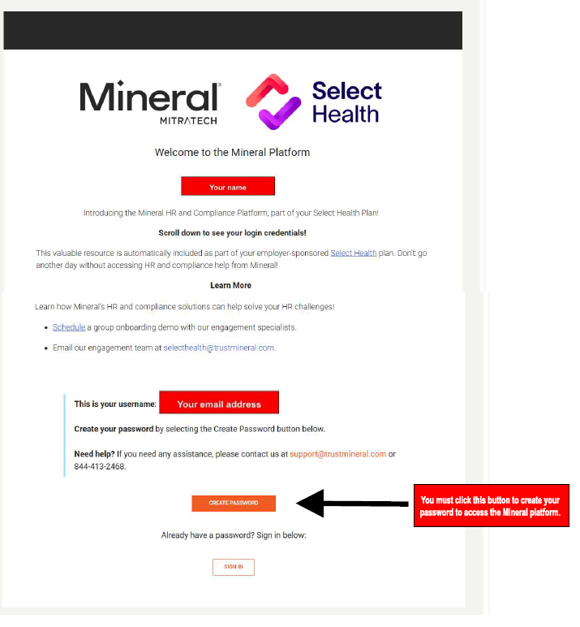

Client Contact Schedule
How do clients get access to Mineral and when will they get access?
Jan
30 - 45
2025
Phone Call
Days
Effective date
For new groups – Mineral access will align with the group’s medical plan effective date, clients can expect to receive communication from the Mineral team to access their Mineral Platform.
Mineral will reach out to schedule a Mineral Platform get started/training session..
Clients will receive a Mineral Platform welcome email.
Notes:
How do clients get access to Mineral and When will they get access?
Select Health provided Mineral with a list of their small group clients on the 20th of each month.
The Select Health + Mineral welcome email will be sent to the client administrator of the business 30-45 days from their medical plan effective date.
The welcome email will contain a username and a link for the client to set up their password to their personalized Mineral Platform.
The platform is personalized for each employer based on the states they do business and the states they have employees (remote workers), the number of enrolled employees with the plan, and the industry they do business in.
All the HR and Compliance services are housed within the Mineral Platform. Encourage your clients to keep an eye out for their welcome emails.
You can help by ensuring you include a client administrator name and email address when signing on new groups with Select Health.
The Mineral team will also be reaching out to groups by phone to schedule a Mineral Platform get started/training session to help get them started.
As the trusted business advisor to your clients, you can let them know to expect outreach from the Mineral team and encourage them to take advantage of the HR and Compliance services. This level of HR and Compliance support is typically afforded to large companies. Because of Select Health, these enterprise-level HR and Compliance services are now accessible to your small group clients.

Slide 9
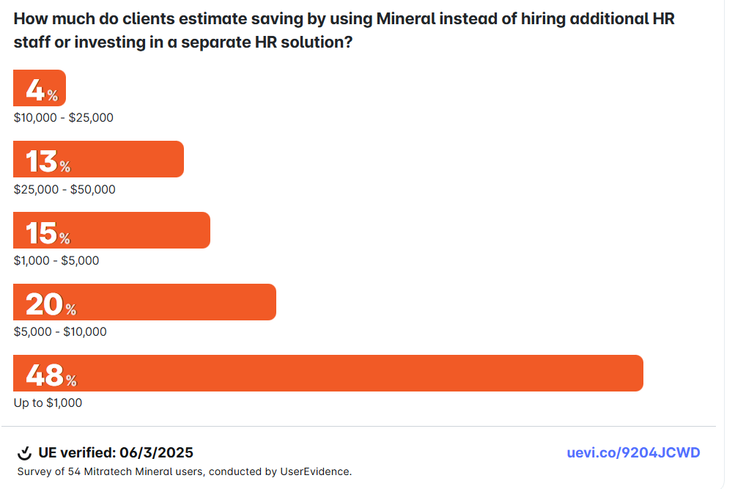
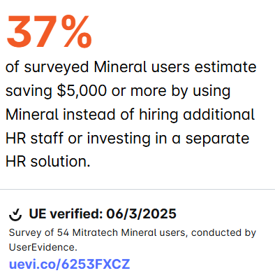
Notes:
How is Select Health and Mineral helping employer clients?
By saving them significant amounts of money by including Mineral’s HR and Compliance solution to their medical plan.
We asked the question – How much have you saved on labor or HR technology costs per year by using Mineral.
The results – 80% of clients surveyed estimate saving up to $10,000 with Mineral!
Mineral is helping clients save significant amounts of money on HR and Compliance costs. Money that can be reallocated to other business priorities.

Slide 10
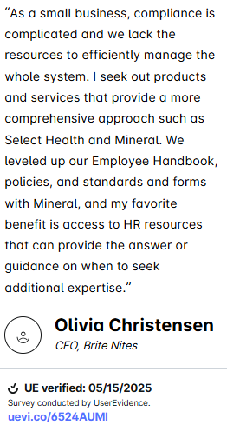

Slide 11
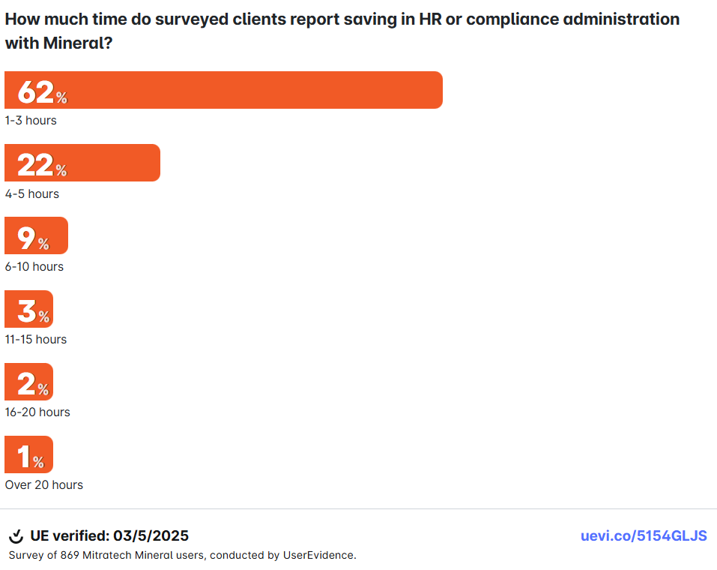
of clients surveyed report saving 4 or more hours a week with Mineral.
37%
Notes:
Mineral is also having a significant impact on helping employer clients save time!
Mineral is helping employers save up to 5 hours a week with the services, resources, and tools they get access to through their medical plans.
Imagine the impact of adding 5 hours a week to other business responsibilities and out of time spent trying to manage HR and compliance duties.

Slide 12
Premium Products with Mineral Elite
Mineral Offering – Mineral Elite |  | Health Plan Premium Offering
Mineral Platform™ | Platform with anytime access to tools, resources, and information that is easy to understand | ✓
Mineral Experts™ | HR-certified experts answer questions in real time | ✓
Mineral Intelligence™ | Proactive recommendations with real-time alerts, timely guidance and tangible action items | ✓
Smart Employee Handbook | State and federal-compliant handbook builder that sends alerts as laws change | ✓
Learn | Learning management system that houses 300+ online training courses | ✓
Core Courses | The Core Courses catalog for Learn fosters continuous learning, improves workforce skills and helps increase employee engagement | ✓
Custom Course Uploader | Tool that enables clients to add custom training to their course catalog | ✓
HR Compliance Library | Searchable library updated with the latest laws and HR best practices | ✓
Notifications | Mix of newsletters, law alerts, webinars and client training | ✓
Benefits Document Creator | Benefit plan documents compliant with ERISA and updated as laws change | ✓
Workplace Harassment Prevention | Workplace harassment prevention training compliant with all state mandates | ✓
Workplace Safety | OSHA tracking and reporting tool with over 125 safety training courses | ✓
Smart Employee Handbook Plus | Living handbook with multistate, send/acknowledgment and Spanish language functionalities | ✓
Cybersecurity | Protect assets and reduce the risk of cyber-attacks with e-learning courses | ✓
Diversity, Equity, Inclusion, and Belonging (DEIB) | Build skills and knowledge for a more diverse and inclusive workplace by training employees | ✓
Communication | Help employees develop the necessary skills to communicate and collaborate clearly and effectively | ✓
Health and Wellness | Increase employee morale, productivity, attendance, and retention through e-learning courses | ✓
Leadership and Management | Gain competitive advantages by developing top talent through e-learning courses designed to strengthen leadership roles | ✓
Microsoft Computer Skills | Ensure your employees are skilled in Microsoft Office for their daily tasks and productivity | ✓
Broker Offering
Mineral® Elite
Premium
Notes:
ONLY USE IF YOU HAVE A BROKER WHO IS ALSO A MINERAL PARTNER
Here is a list of the resources, tools, and services that are included with Select Health’s medical plans that include Mineral.
Mineral Elite – all services listed are included.
Mineral does partner directly with brokers as well. Notice that the broker package with Mineral does not include the additional premium products. If you are a broker who works directly with Mineral, your clients will now have access to the 3 additional products at no cost to you or your clients.
Workplace harassment prevention training courses – Mineral’s most popular employee training course in 2024
Over 125 workplace safety courses
An enhanced employee handbook – meaning employers can build a multistate handbook, get it in Spanish translation, and collect e-signatures all included.
eLearning courses in Cybersecurity, Diversity, Equity, Inclusion, and Belonging (DEIB), Communication, Health and Wellness, Leadership and Management, Microsoft Computer Skills

Slide 13



Mitratech’s Mineral Advantage Program (MAP)
Mineral broker partners may enroll and reduce their Mineral bill.
MAP is for Mineral broker partners.
Brokers can earn credit off their Mineral bill.
Contact your Mineral account manager to learn more about the MAP.
Notes:
ONLY USE IF YOU ARE PRESENTING TO A BROKER WHO IS ALSO A MINERAL BROKER PARTNER
The Mineral Advantage Program is for brokers who partner directly with Mineral. For more information, please have them email our team at selecthealth@trustmineral.com or encourage them to contact their Mineral account manager.

Slide 14
Stay Informed. Share with Confidence.
Resources to help you support your Select Health clients:
✅ Opt in to Mitratech Mineral updates Get timely tips, tools, and webinars from Mitratech Mineral, so you can stay current and confidently guide your clients. 👉 Subscribe to receive updates
✅ Access the Select Health + Mineral Marketing Toolkit Easily share the value of Mitratech Mineral with your Select Health clients. 📦 Explore the toolkit
Contact the Mitratech Mineral team at: selecthealth@trustmineral.com
Notes:
Here are the key takeaways we would love for you to remember.
Encourage you to watch the video – it is only 14 minutes and you can view it at your leisure.
Mineral provides you with a resource for your Select Health clients when they turn to you for HR and compliance questions and you can have peace of mind knowing you are sending them to a trustworthy and reliable resource.

